Slide 1
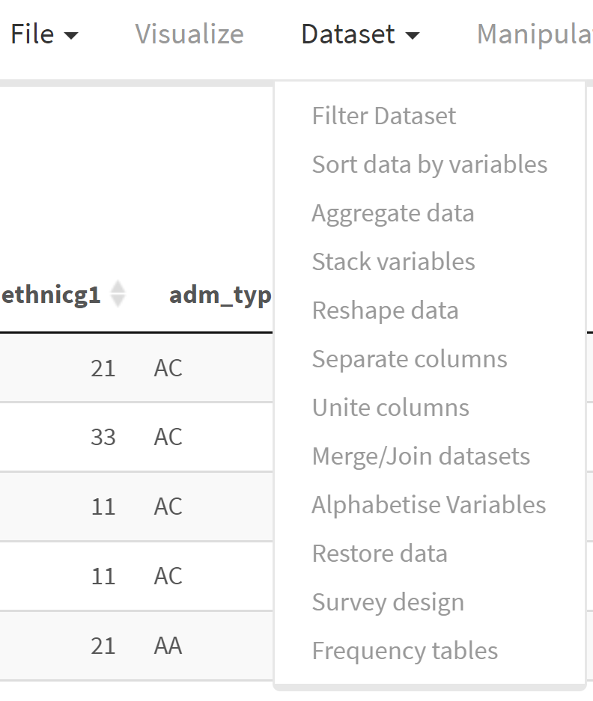
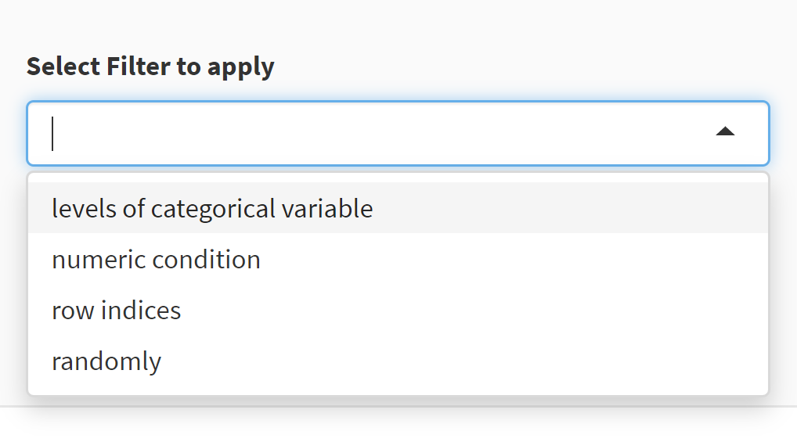
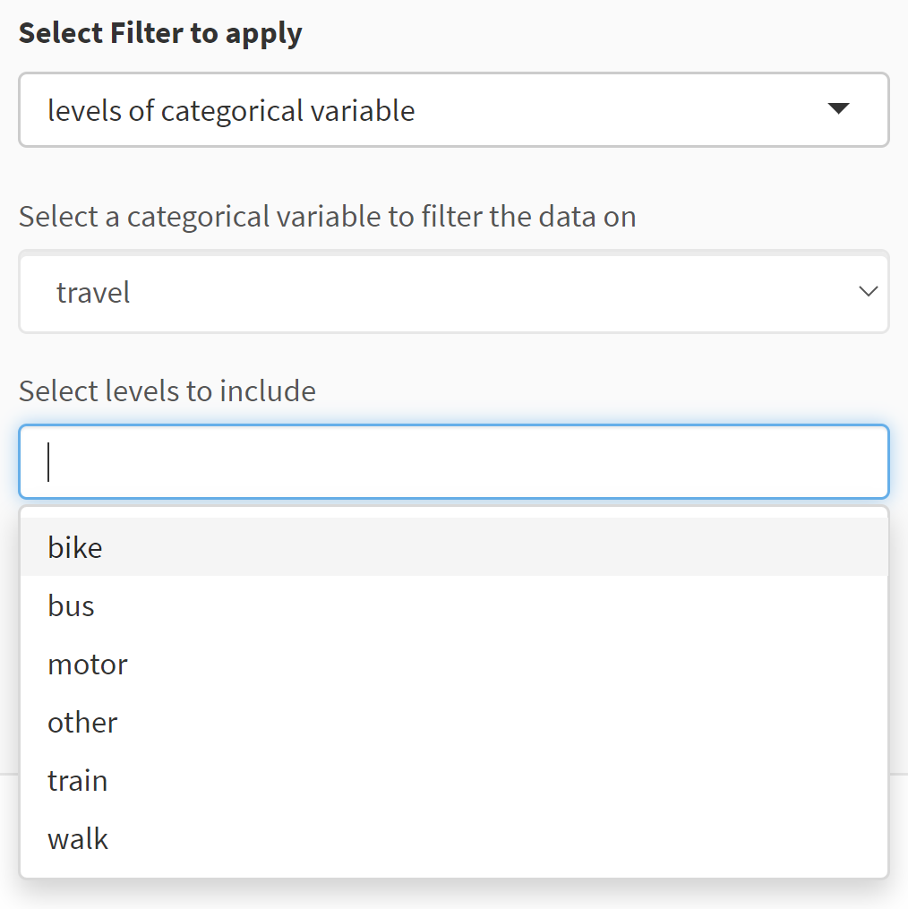
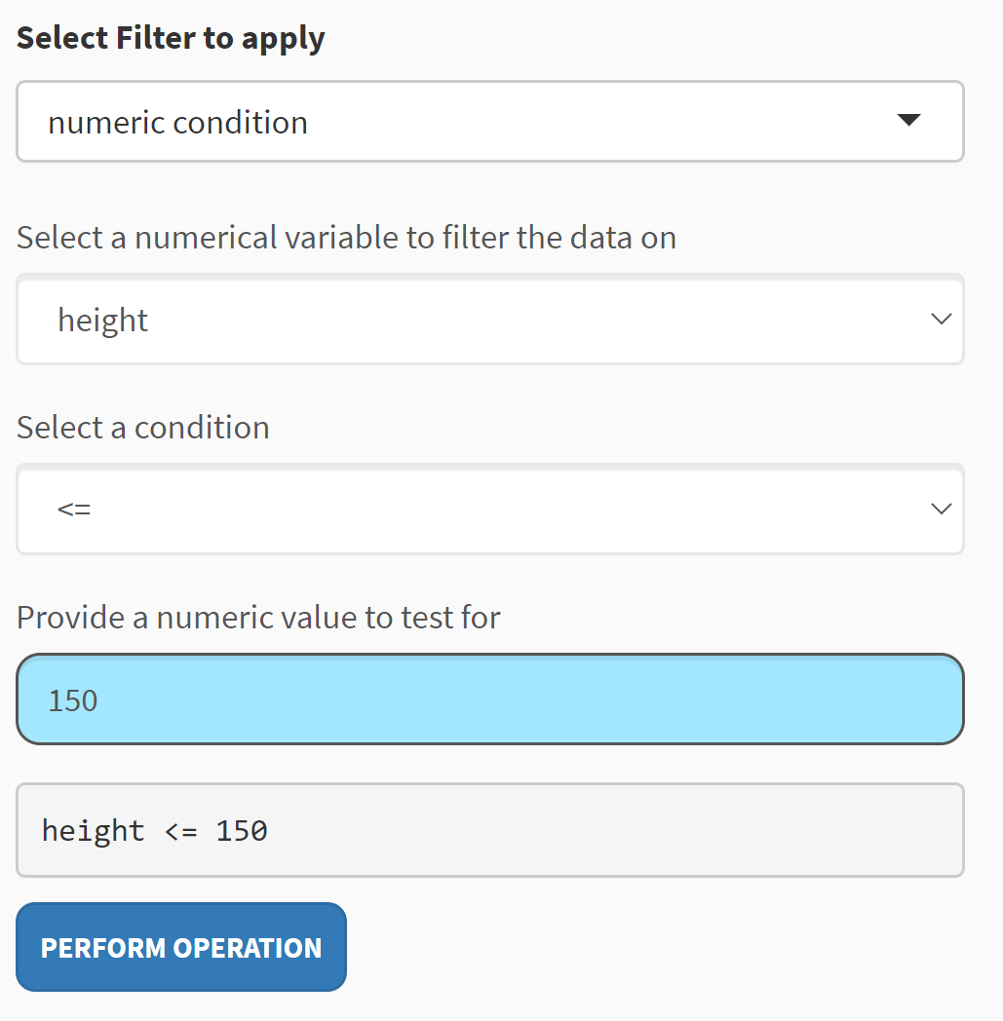
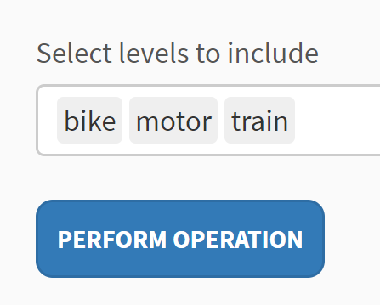
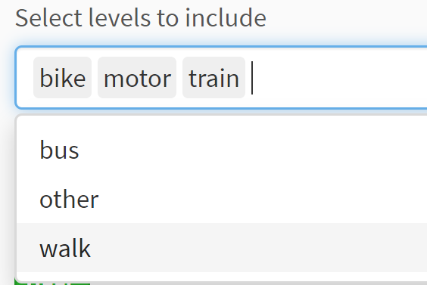
(Left-hand)
Control panel
changes to
Expands to
Choose variable
Changes to
Choose variable
Click to reveal levels
Keep clicking desired
levels
When finished,
click outside this dropdown
Select condition
Click to perform
the filtering
Type a value
Click to perform
the filtering

Slide 2
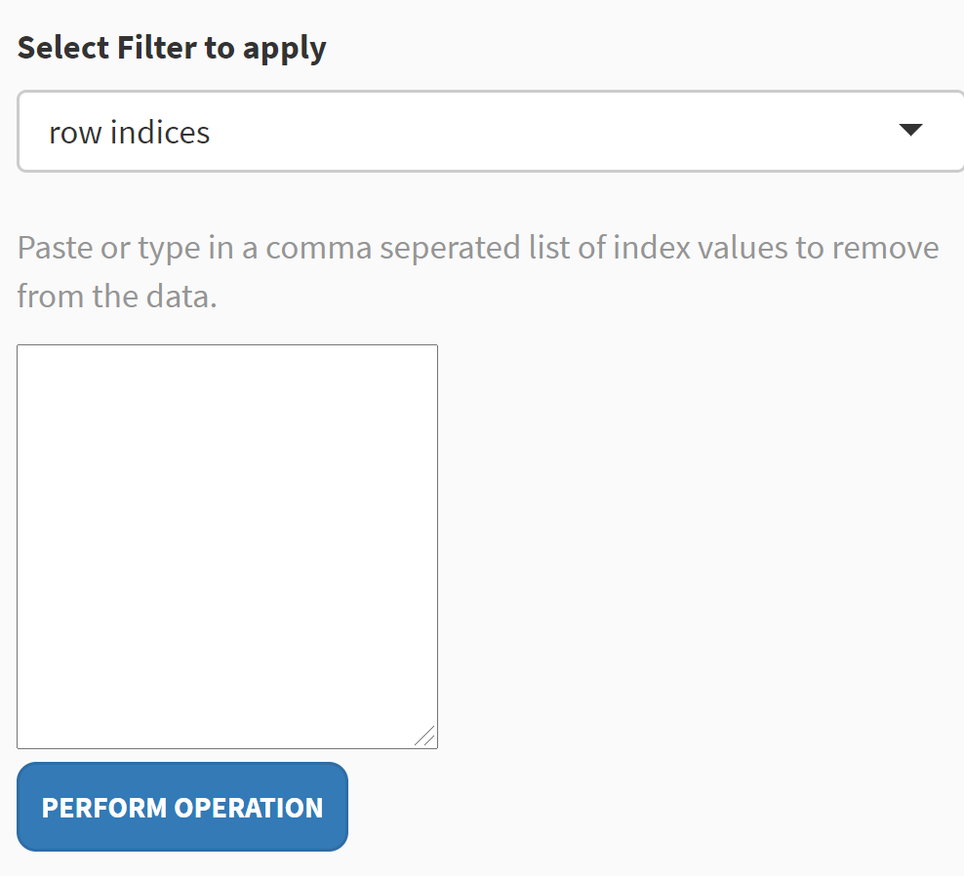
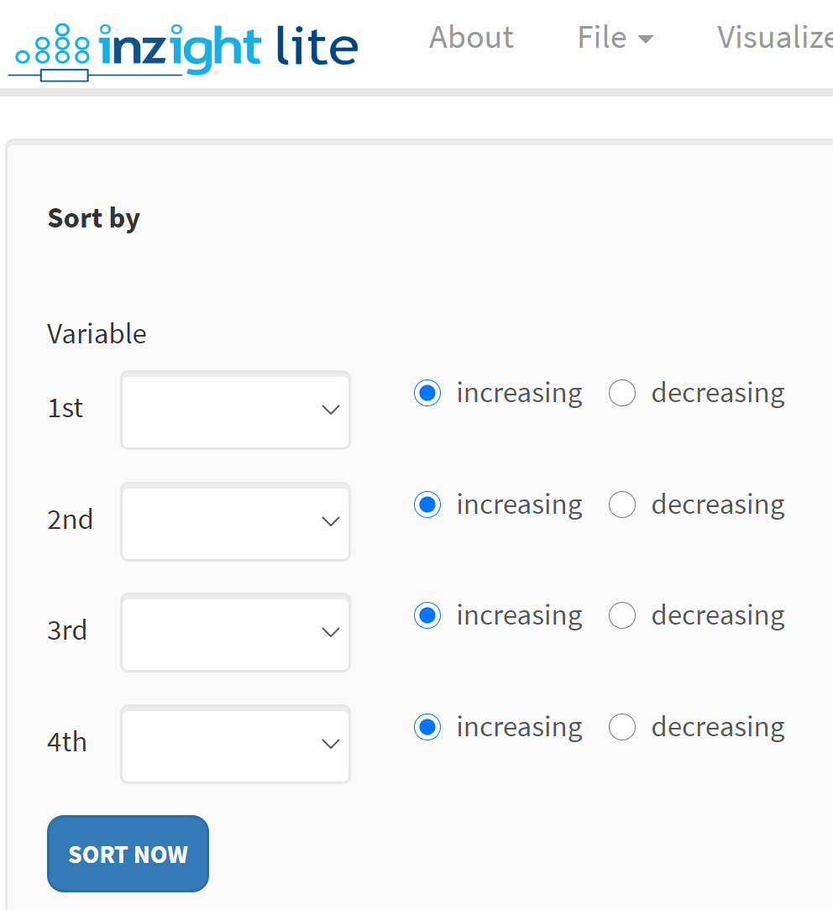
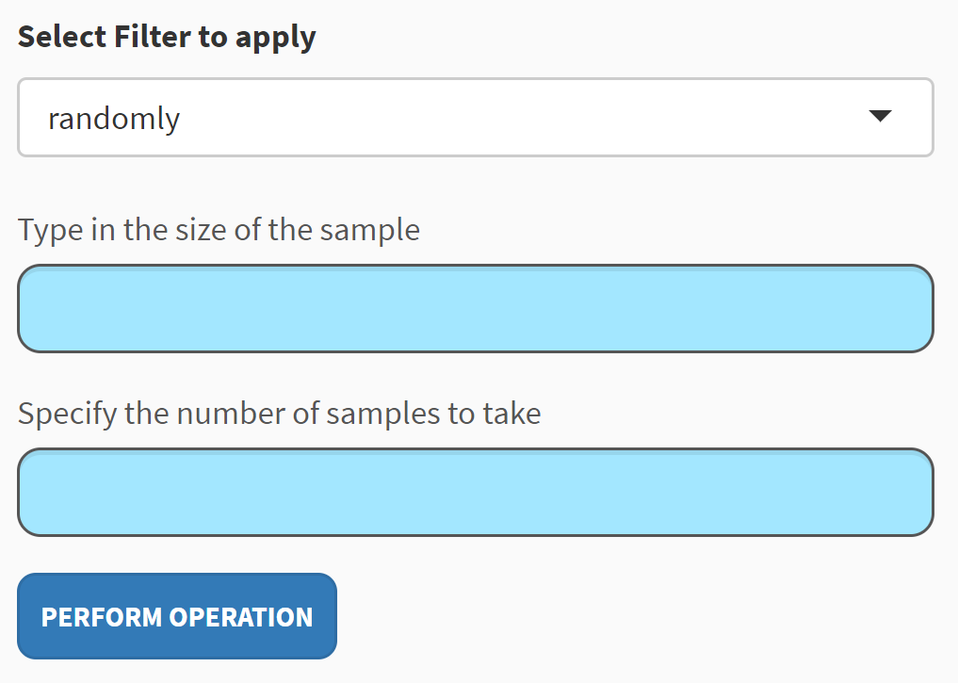
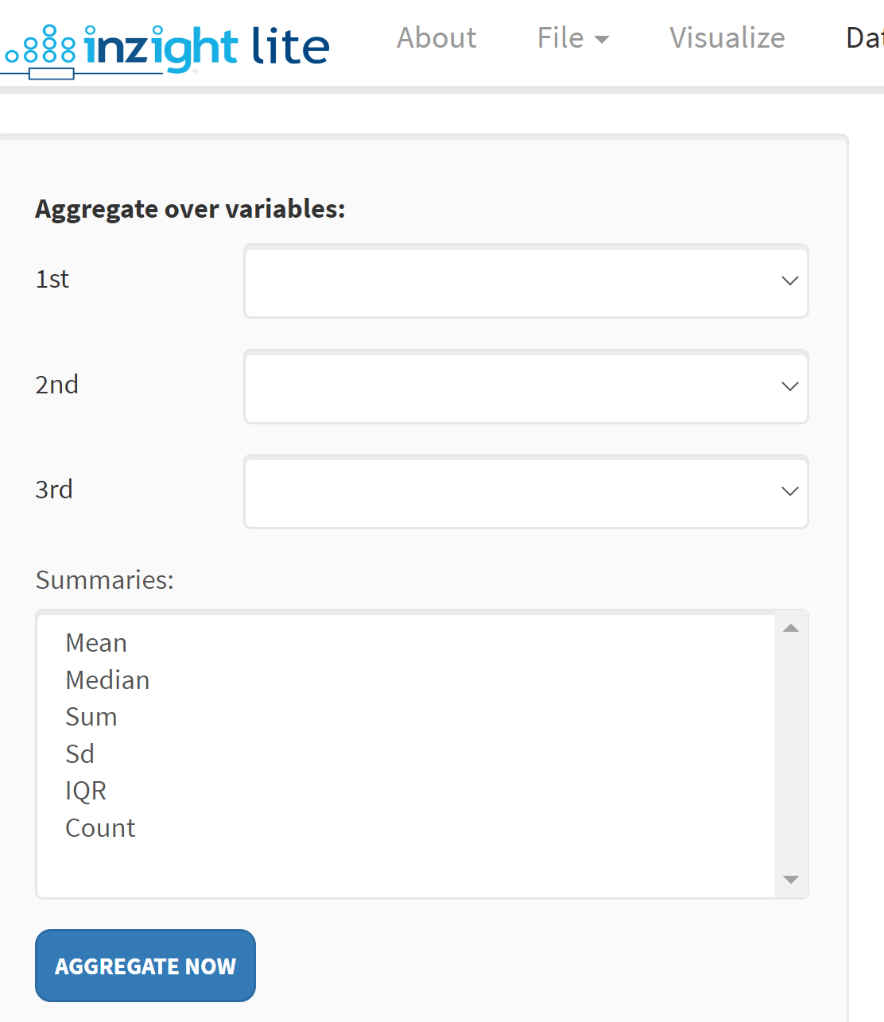
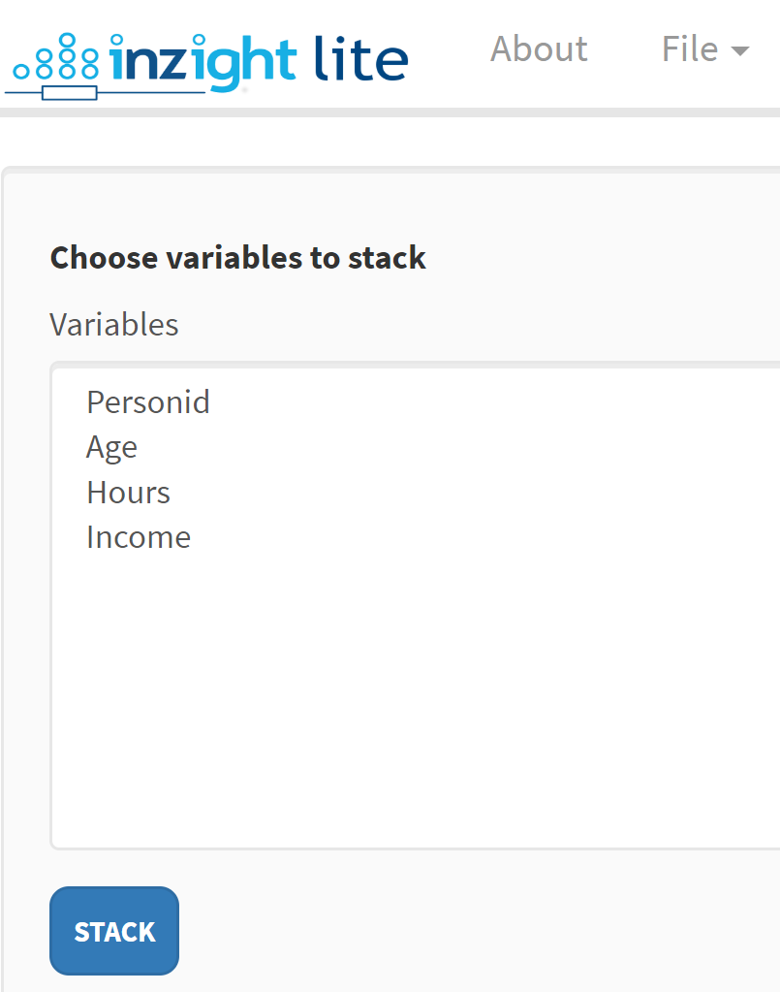
Paste or type in here
Click to perform
the filtering

Slide 3
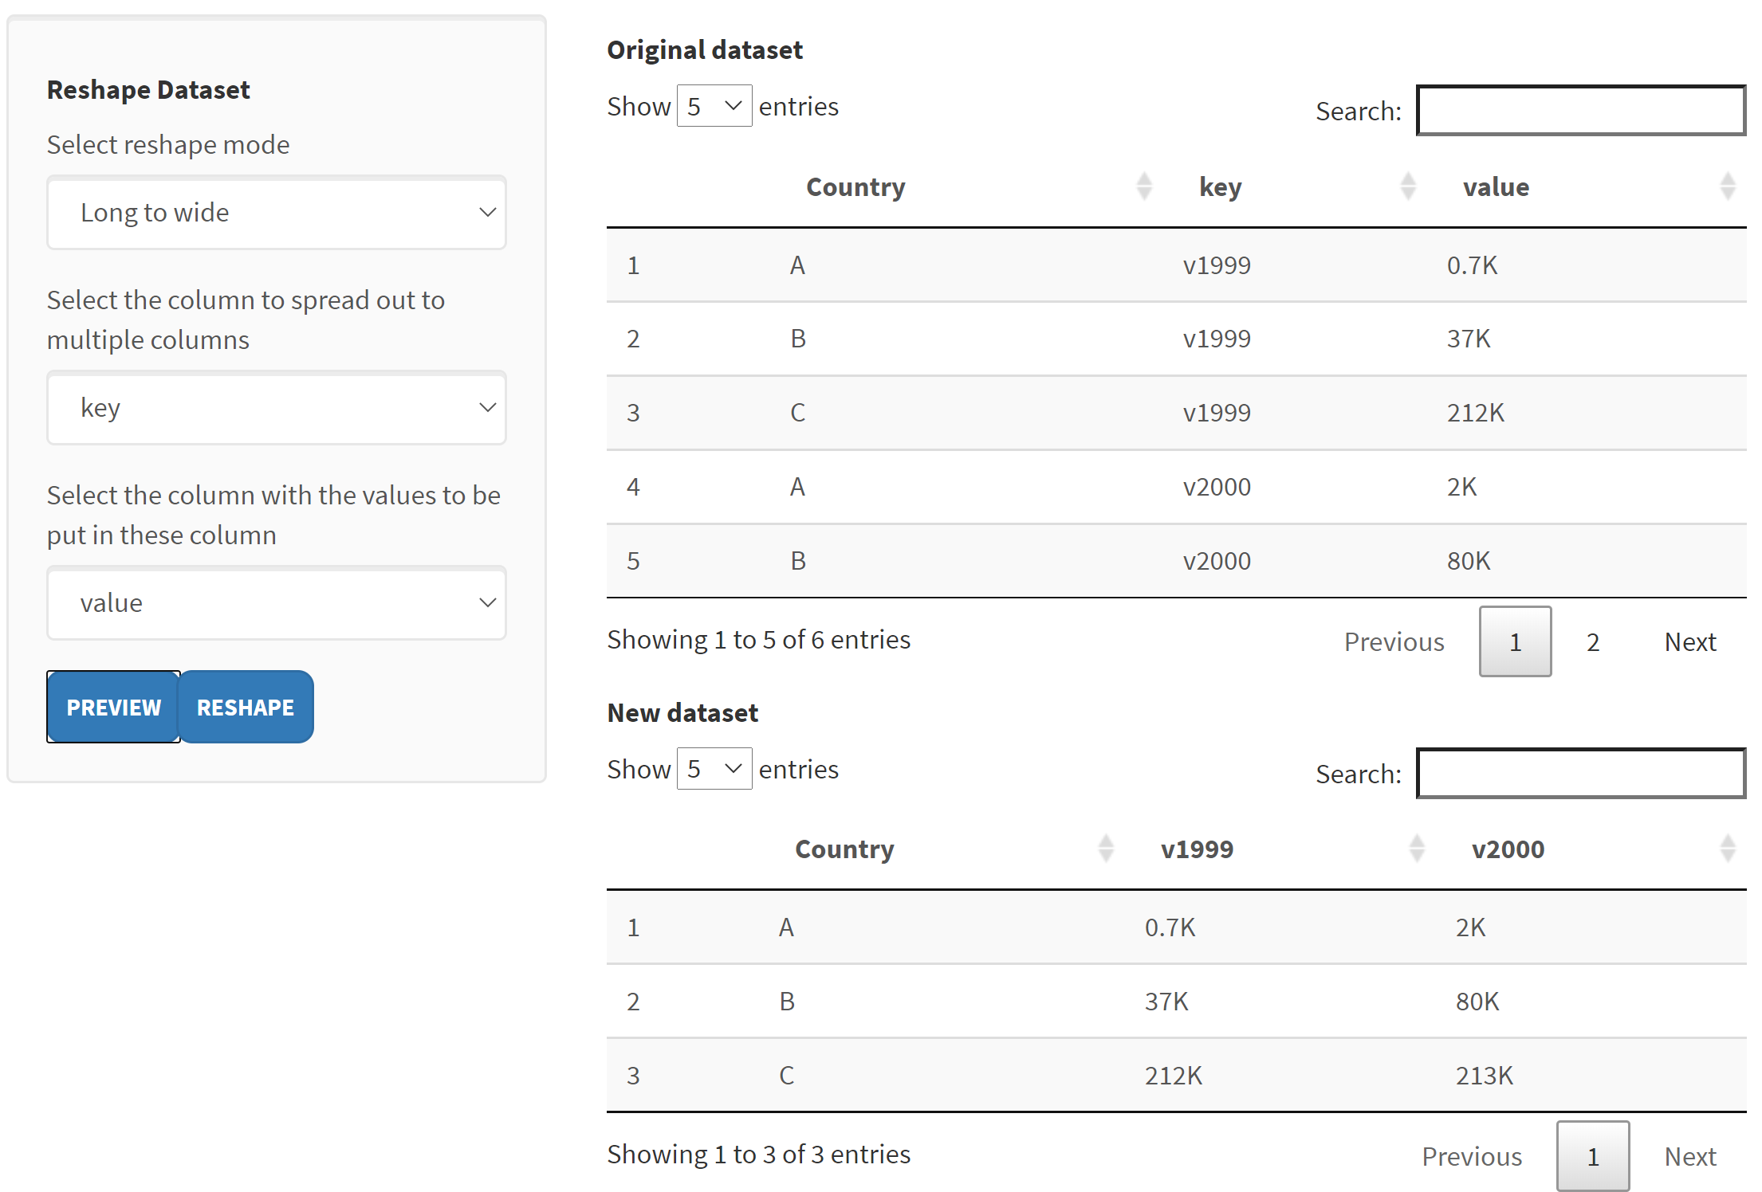
Click to expand
Choose
Appears after selecting columns and clicking
PREVIEW
Click RESHAPE to finalise

Slide 4
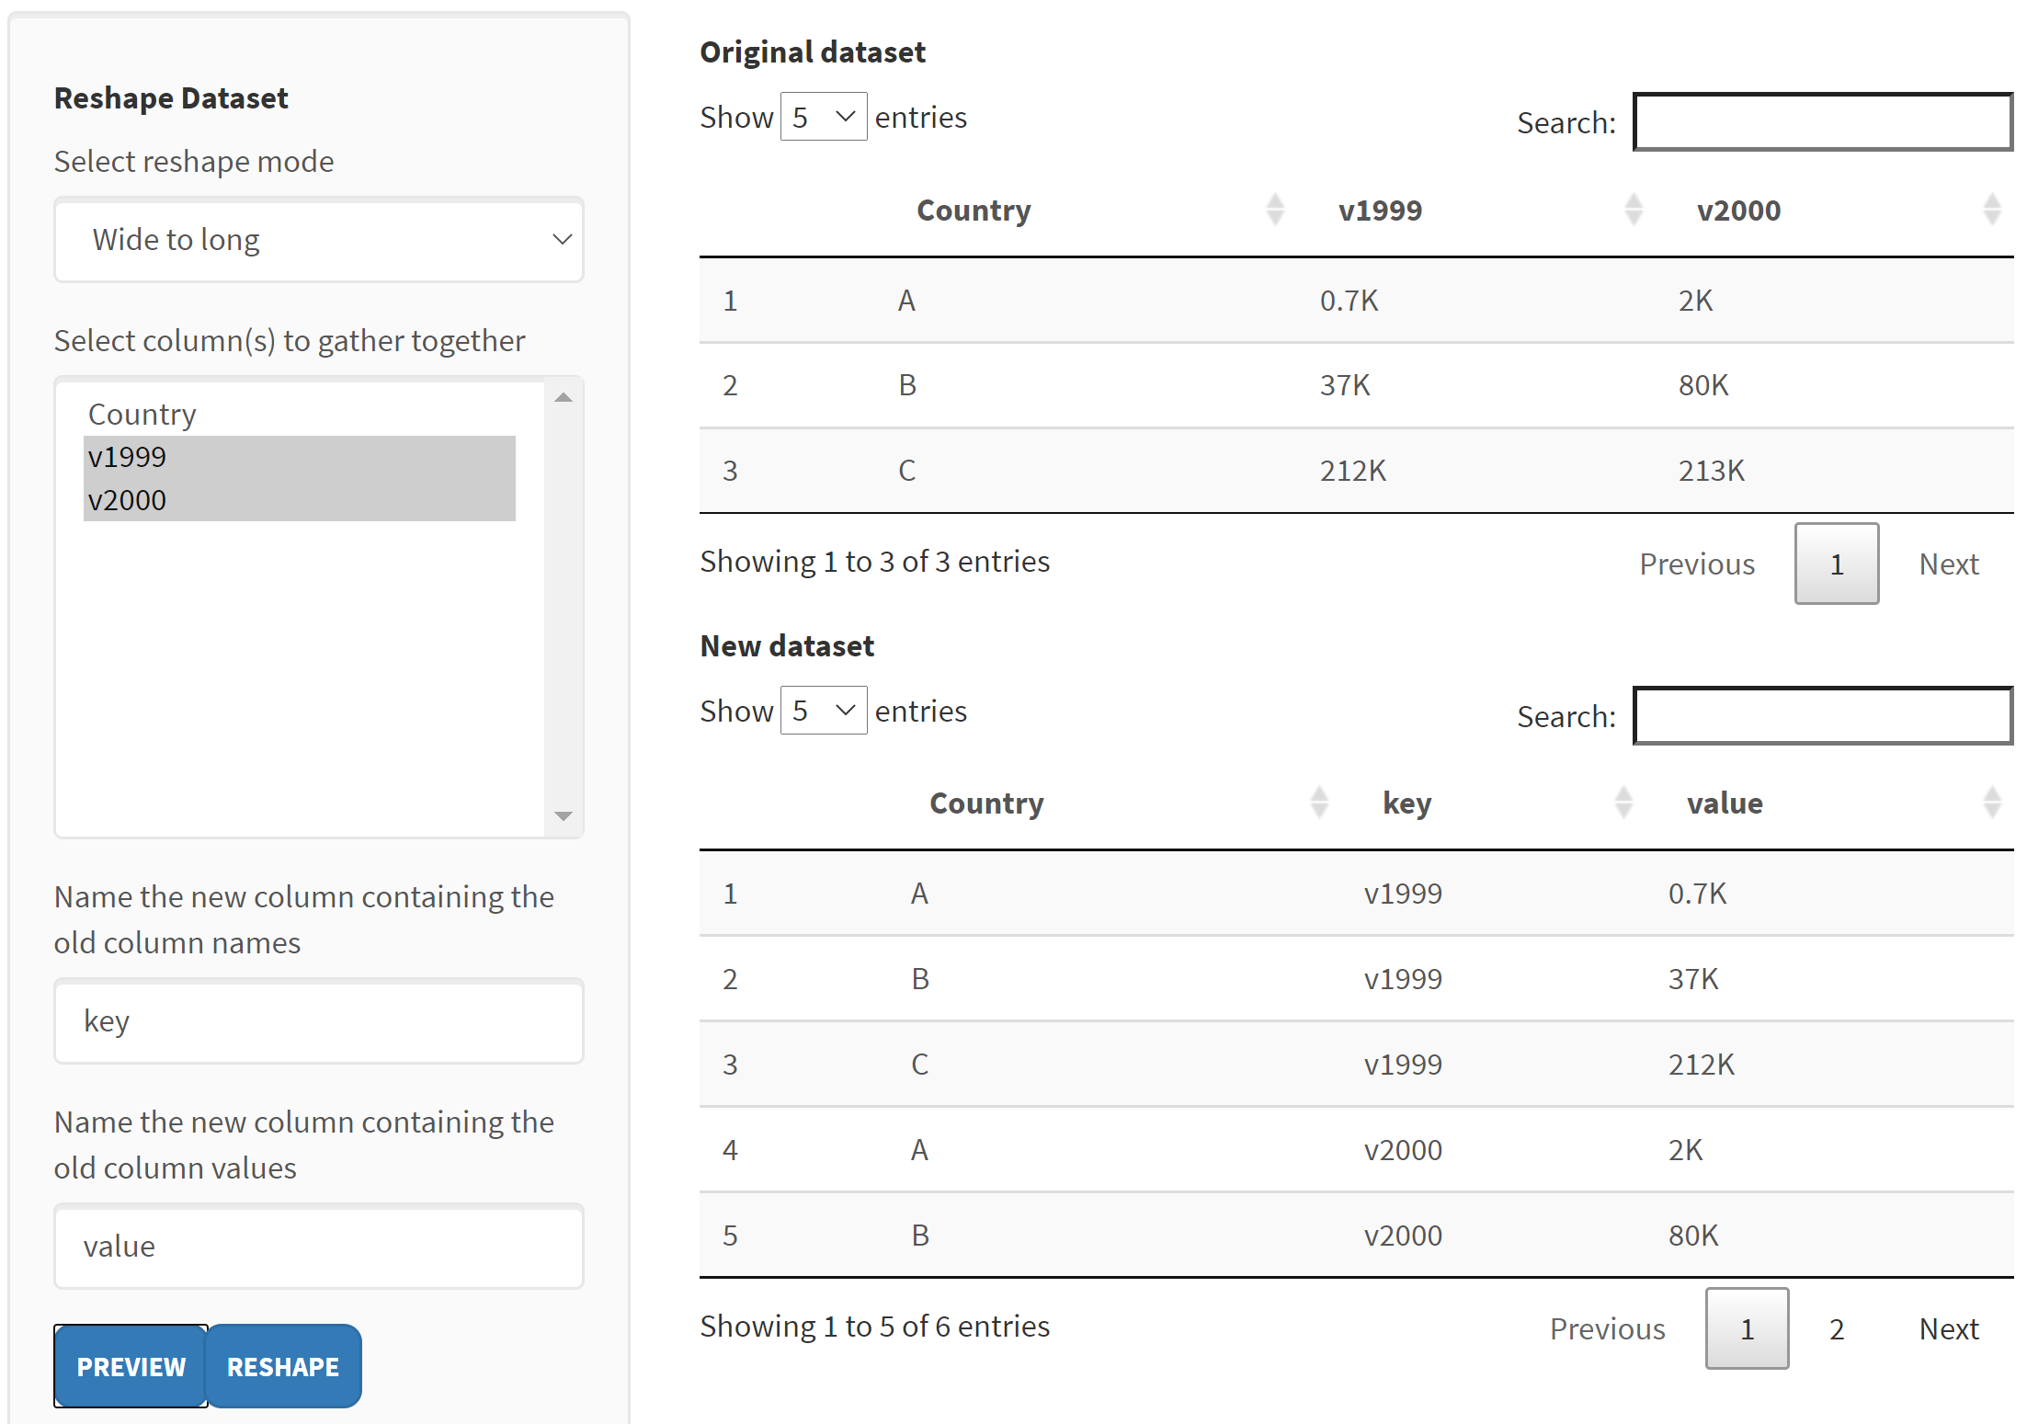
Appears after selecting columns and clicking
PREVIEW
Click RESHAPE to finalise

Slide 5
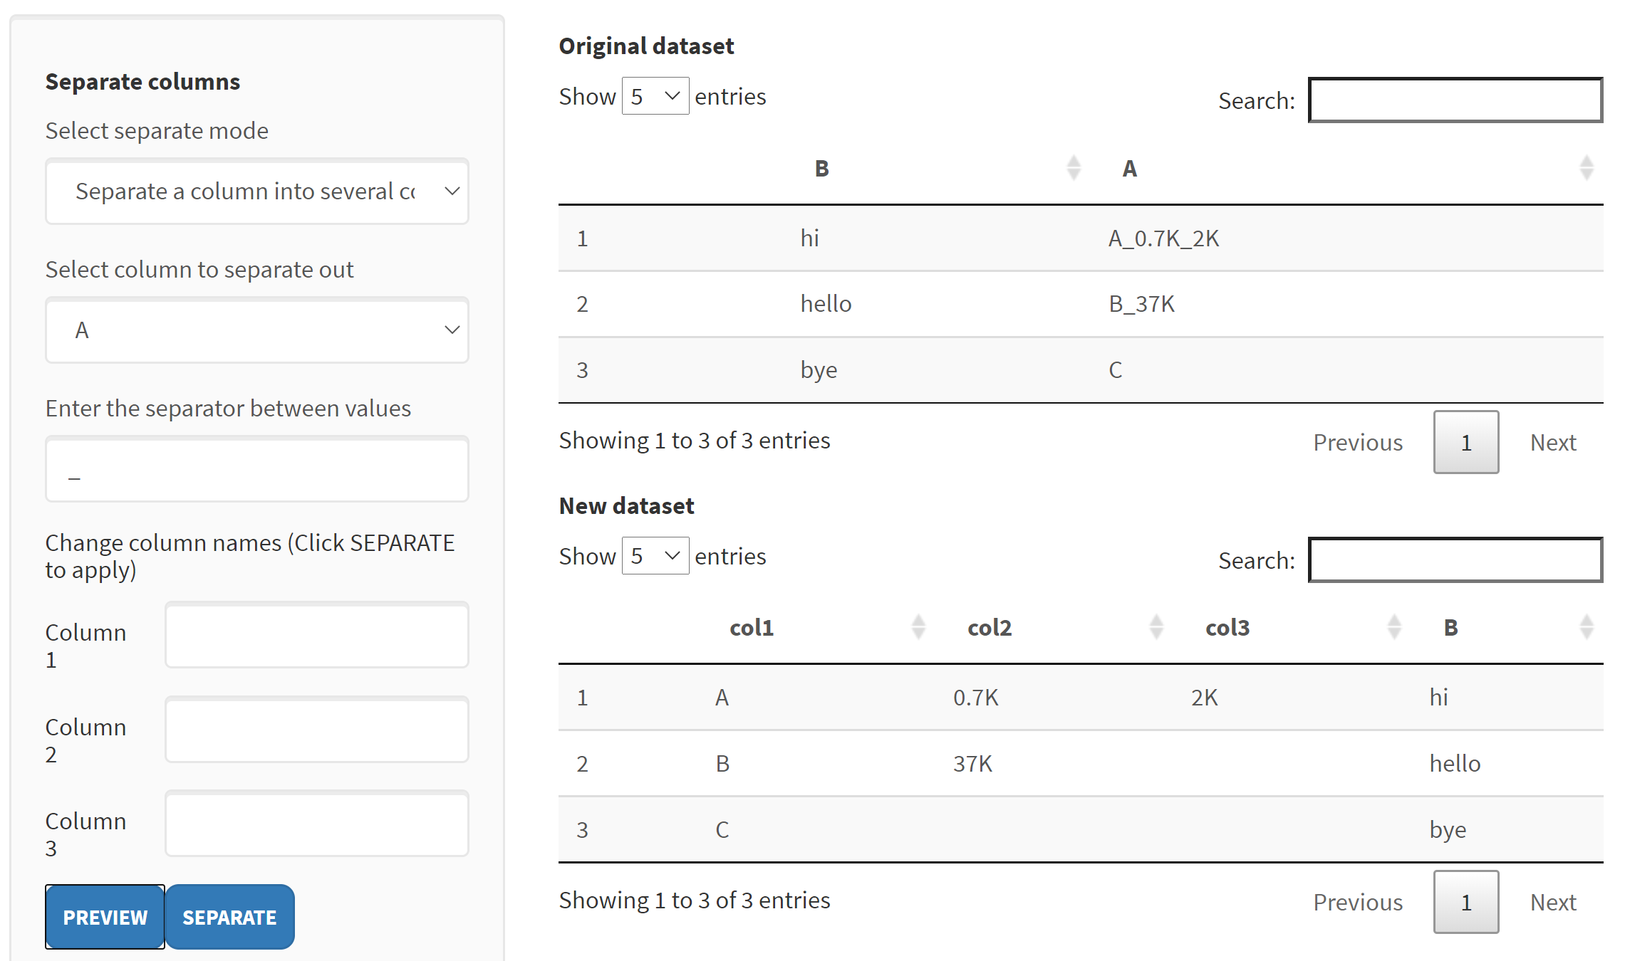

Click to expand
Appears after making selections and clicking
PREVIEW
Appears after selecting columns and clicking
PREVIEW
Choose
Click SEPARATE to finalise
Click SEPARATE to finalise

Slide 6
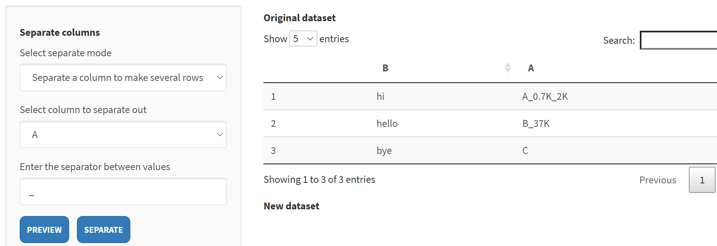
This is broken. Fix picture when fixed

Slide 7
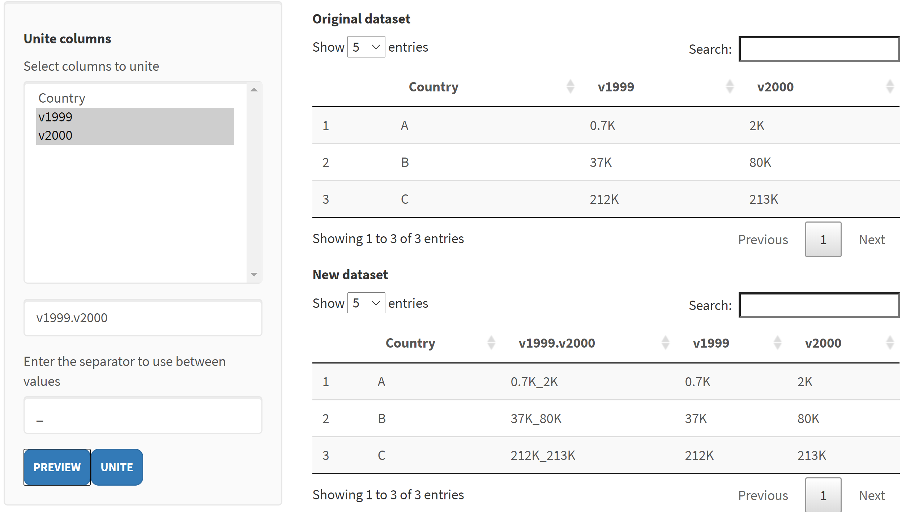
Appears after selecting columns and clicking
PREVIEW
Click UNITE to finalise

Slide 8
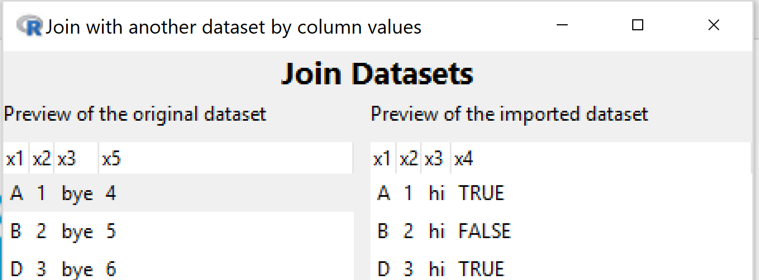
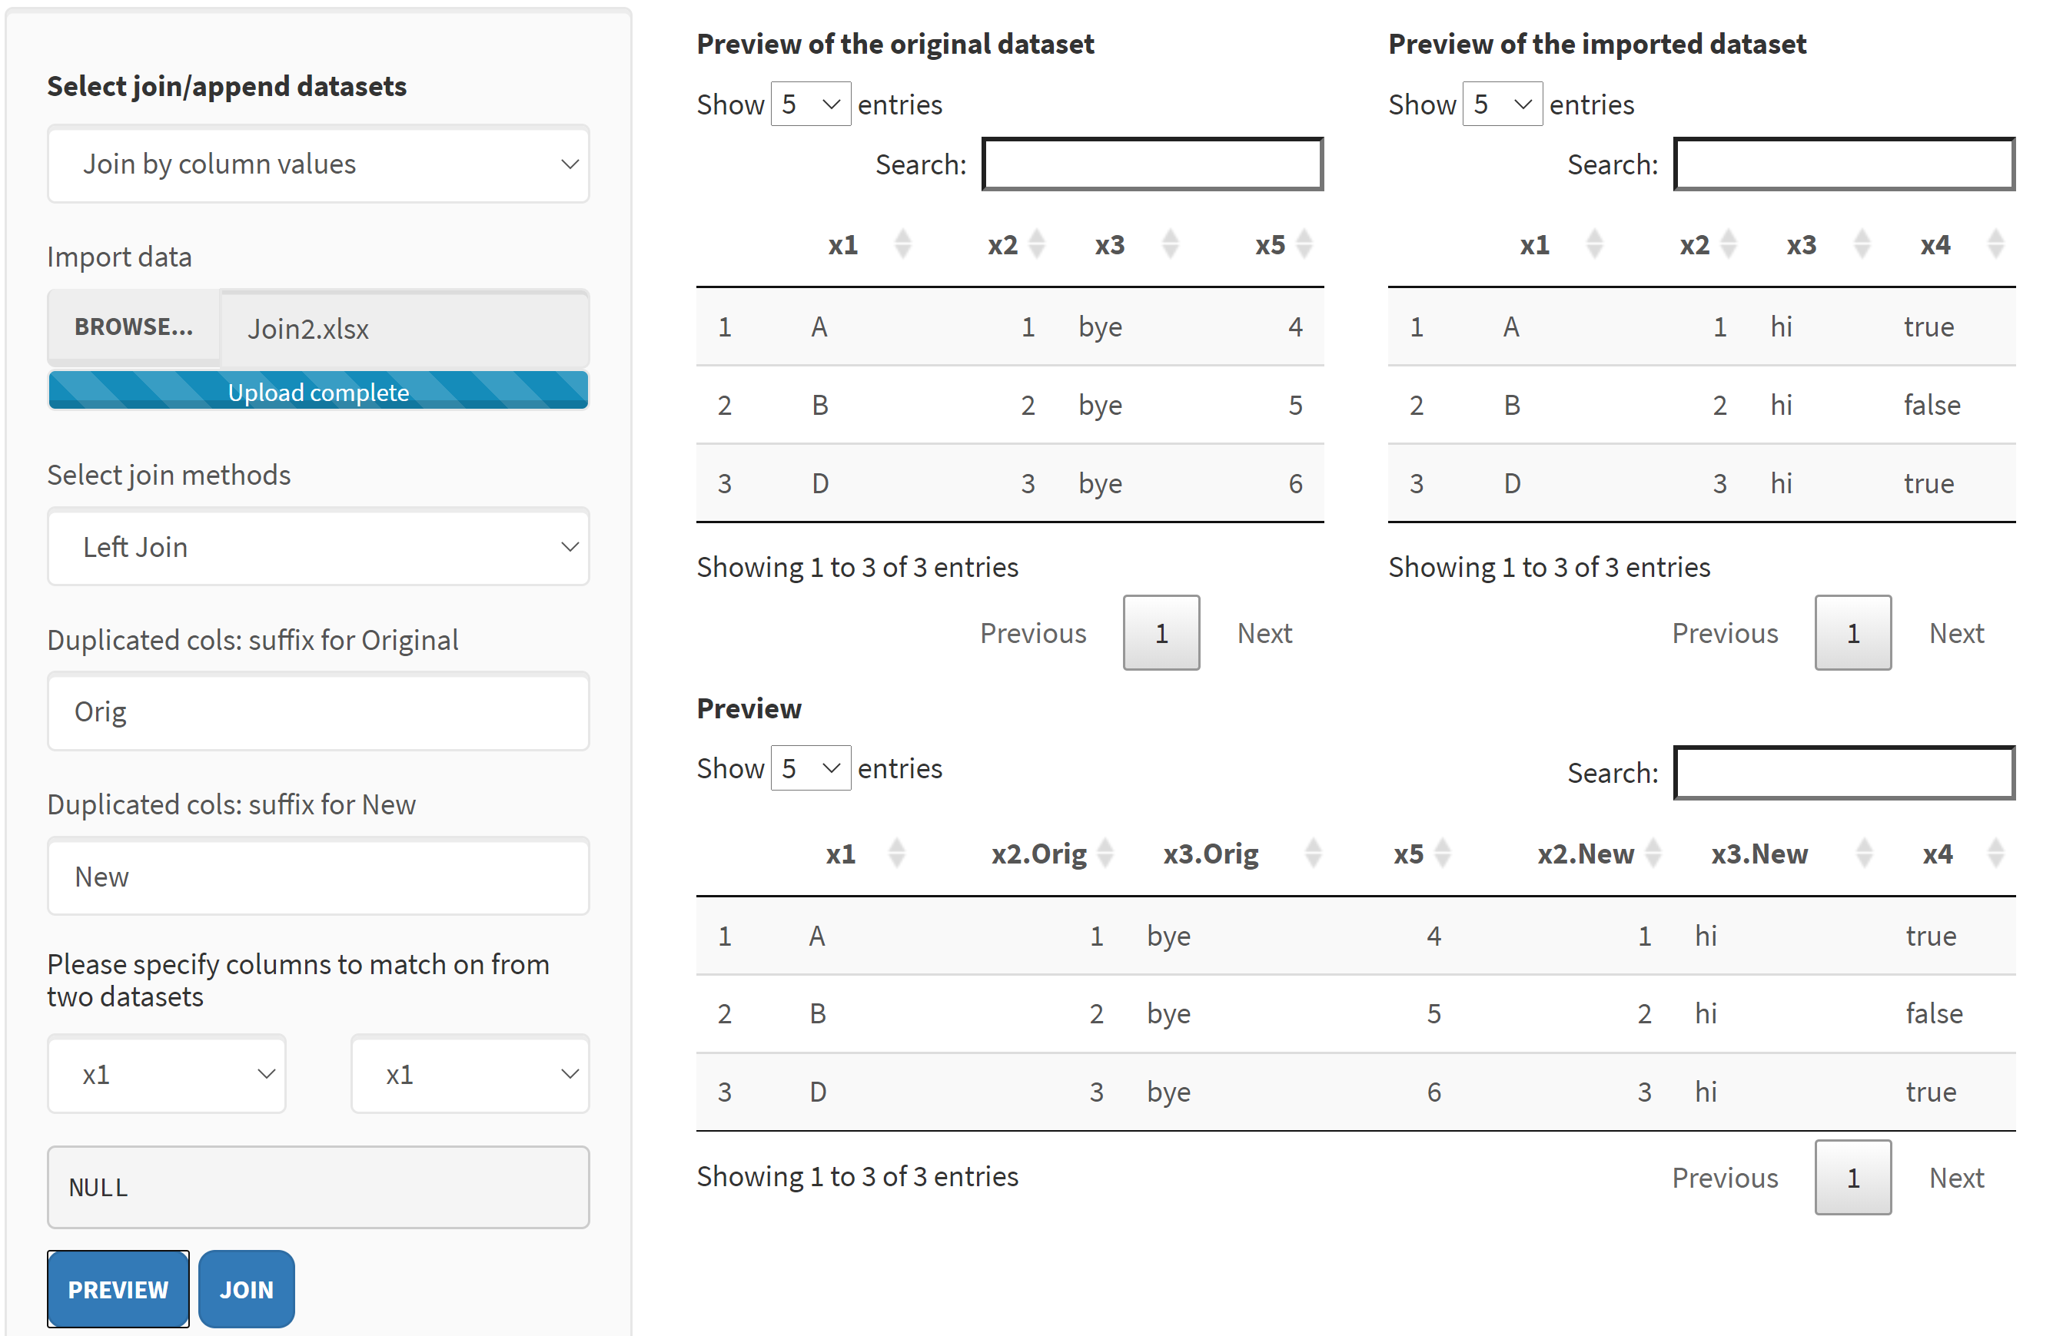
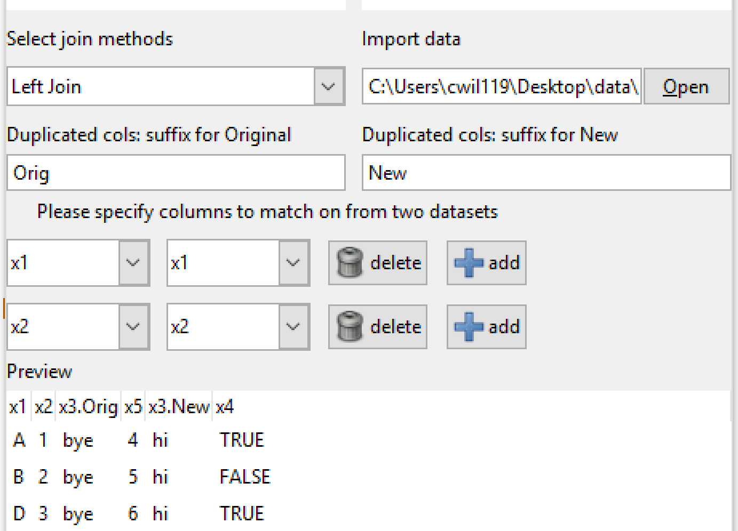
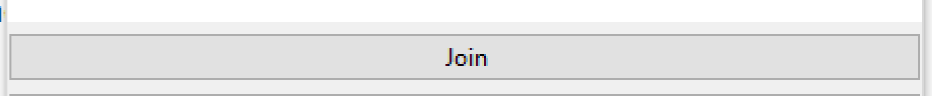
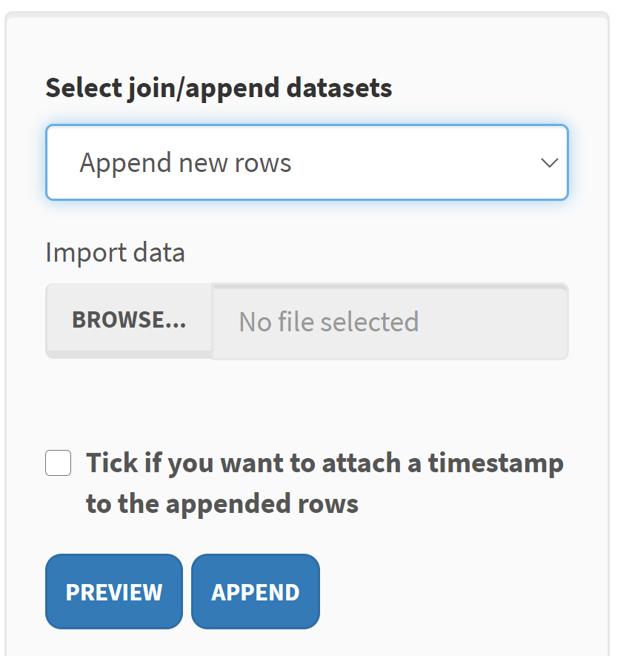
Appears after selecting columns and clicking
PREVIEW
Click JOIN to finalise

Slide 9
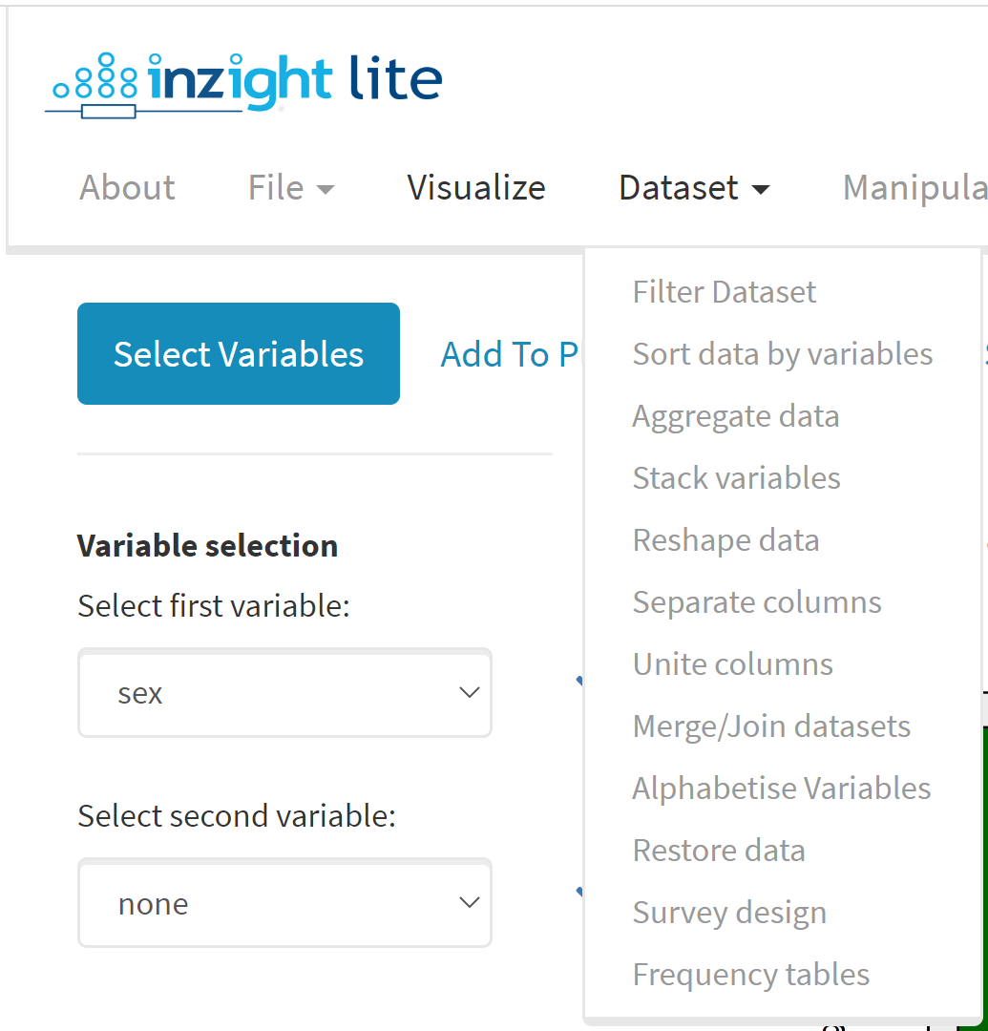
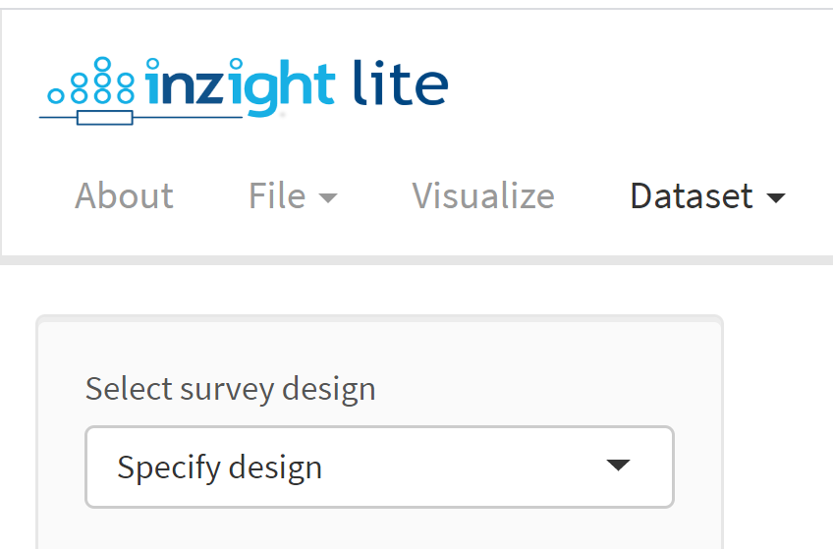
drop-down
Click to expand
Choose

Slide 10
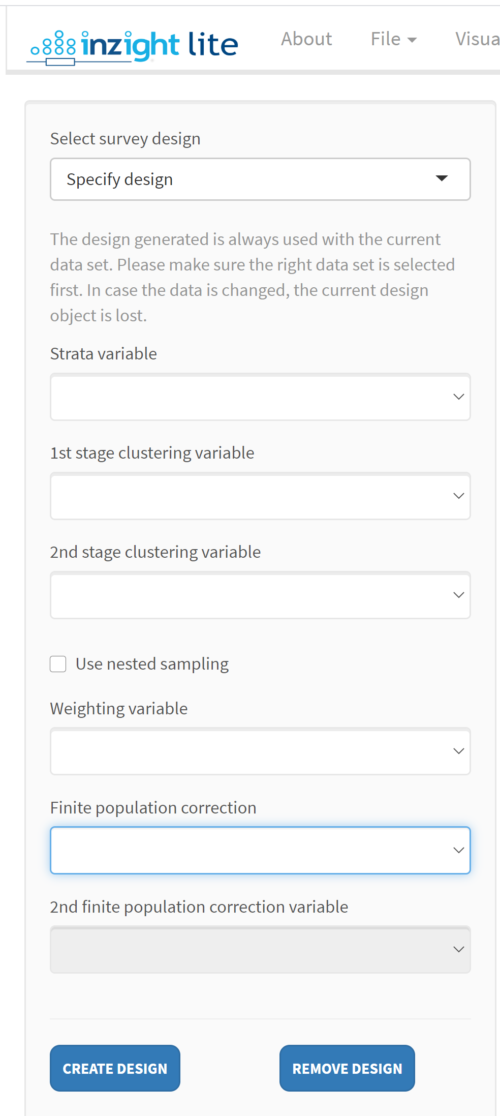
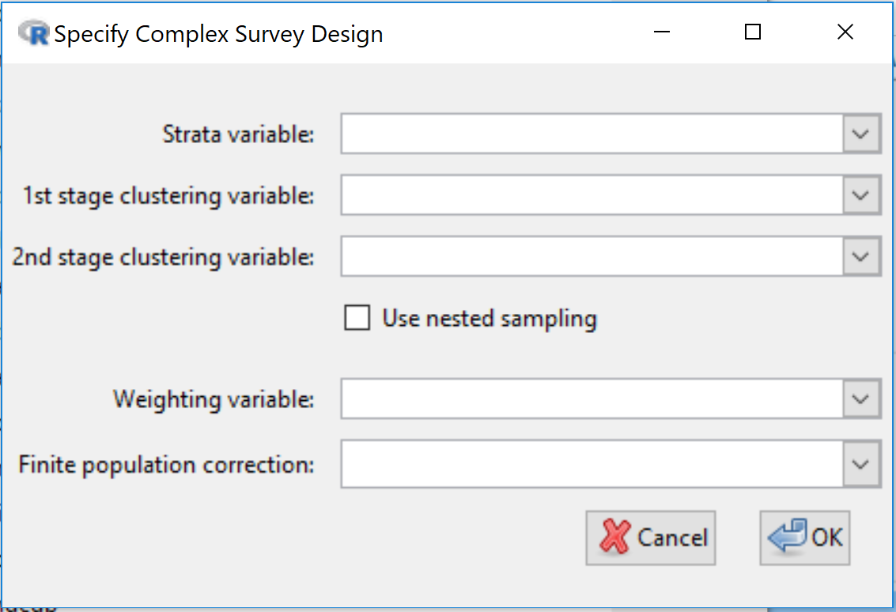

Slide 11
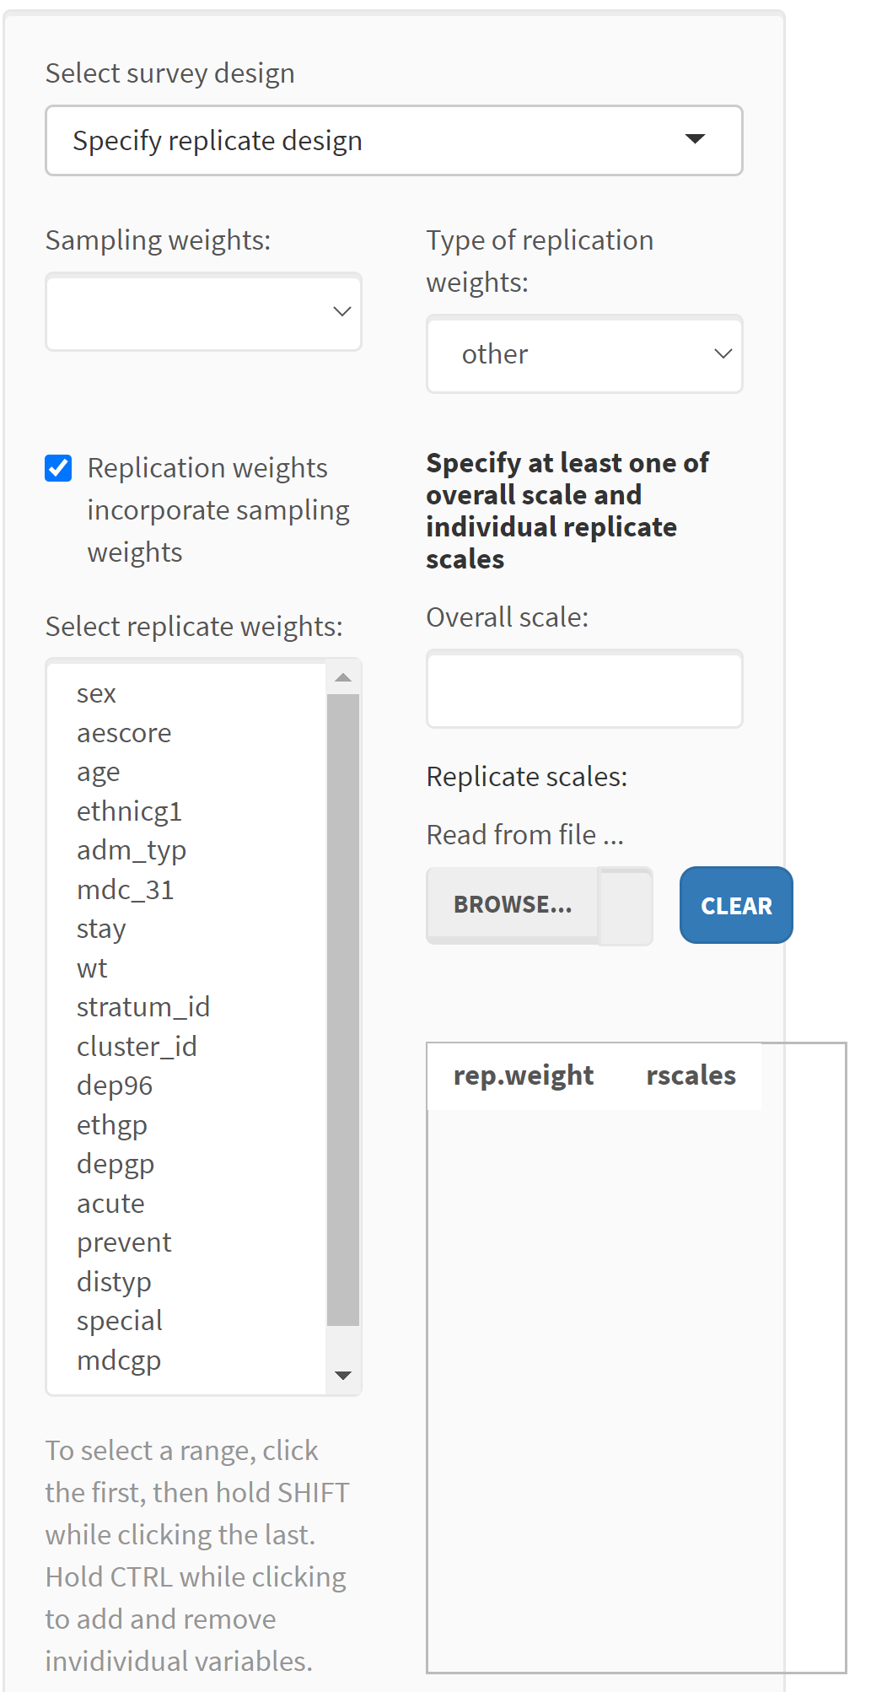
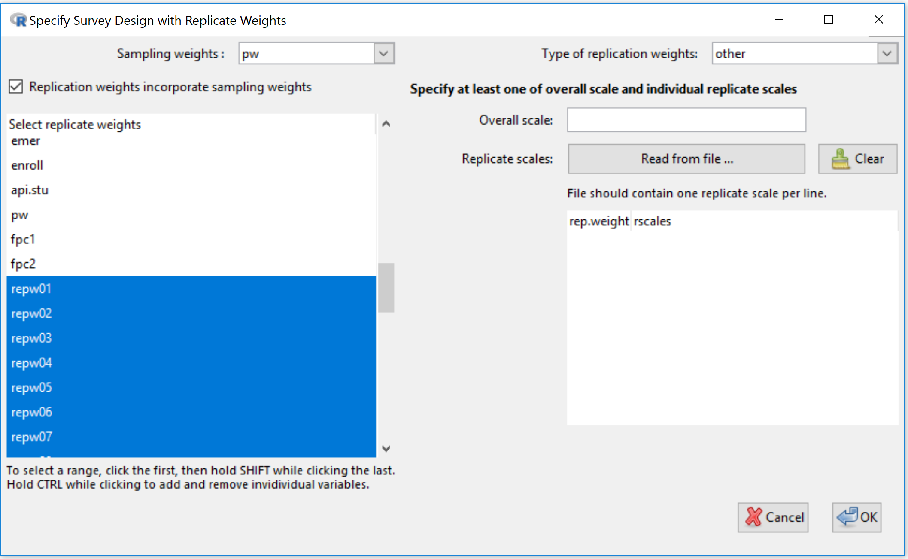

Slide 12
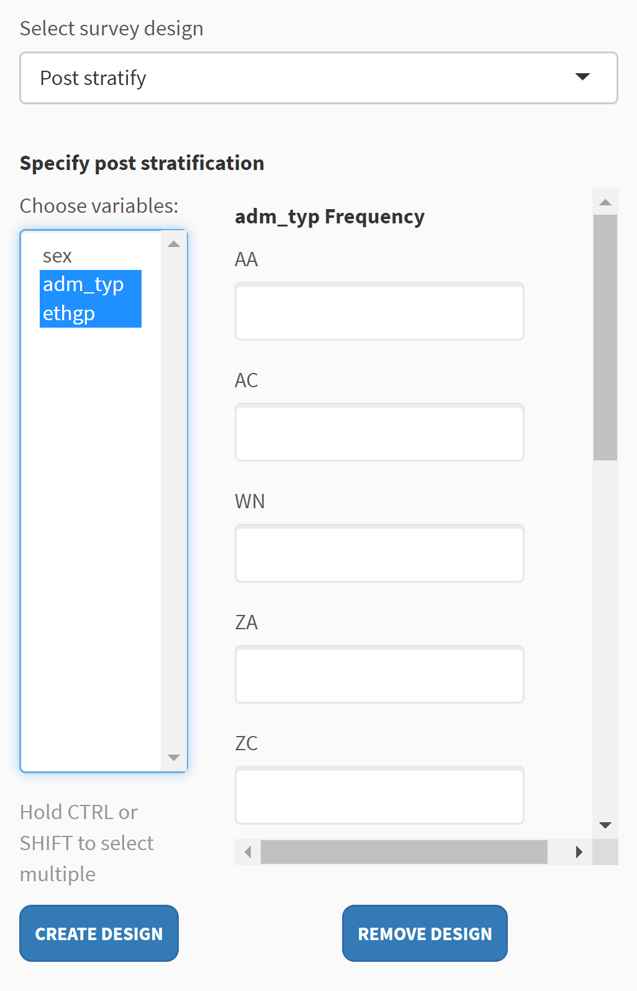
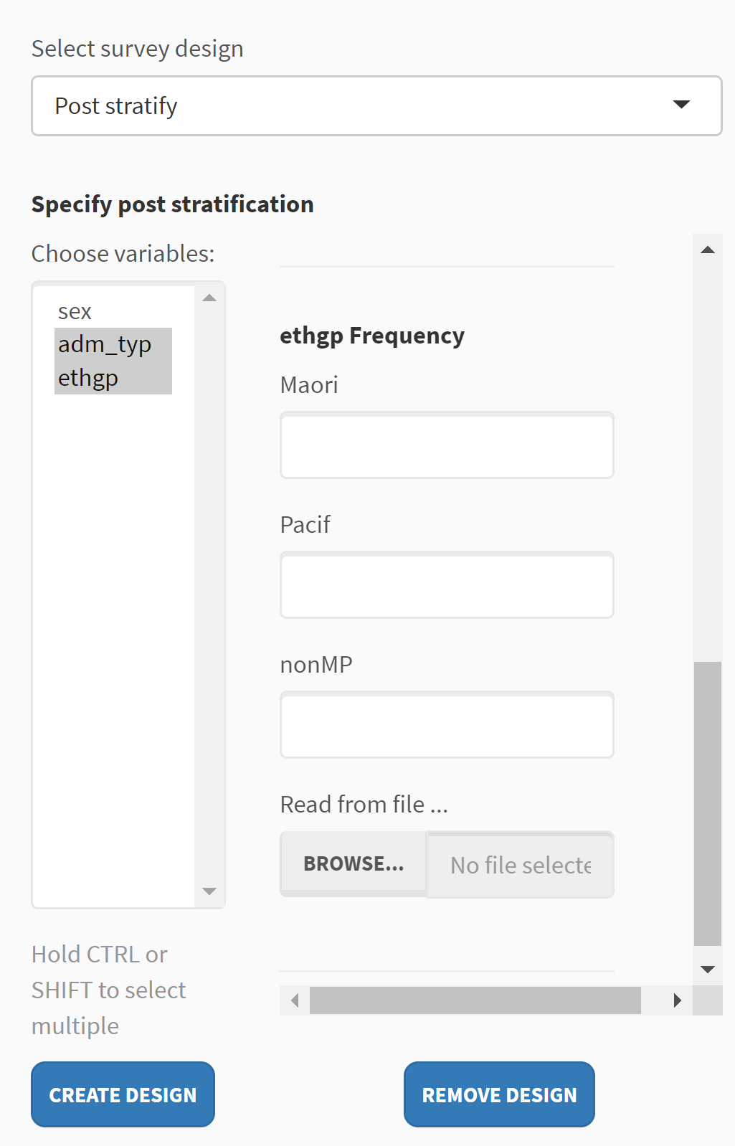
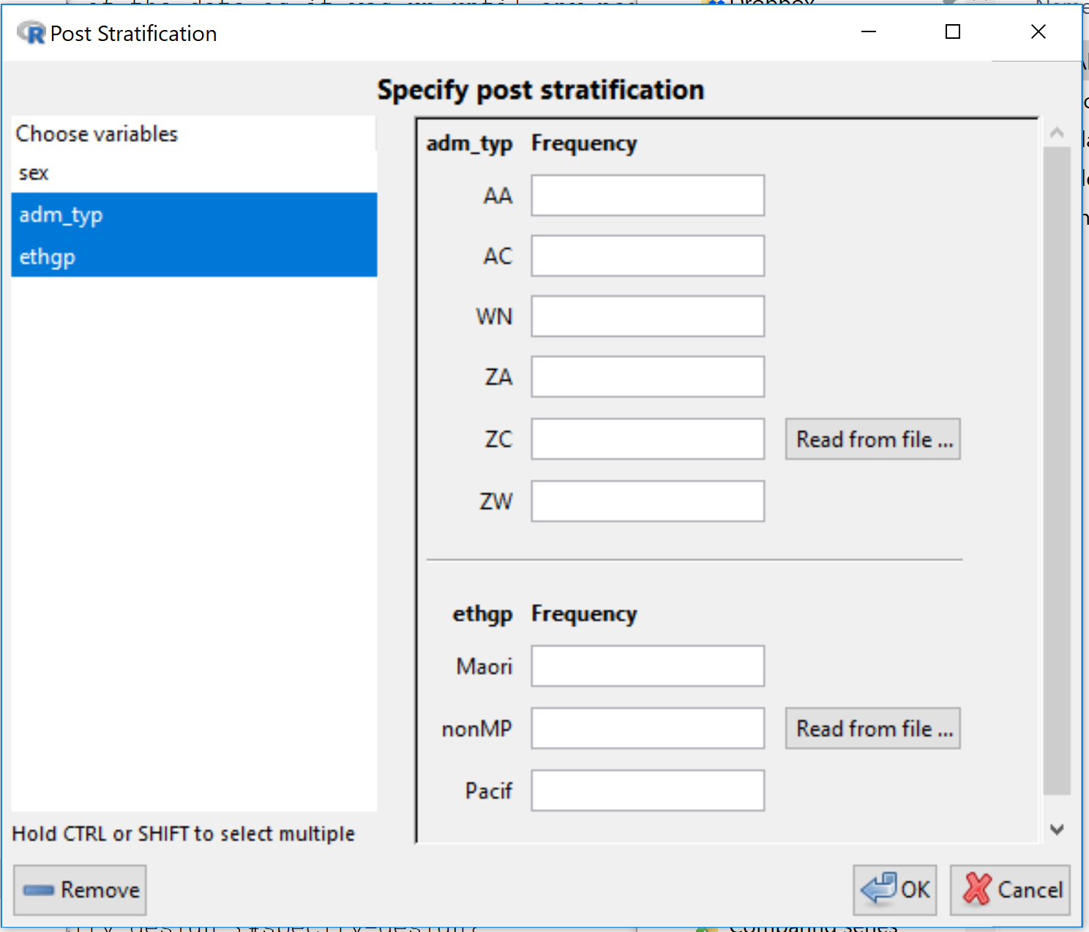
Scrolling down to
see the rest

Slide 13
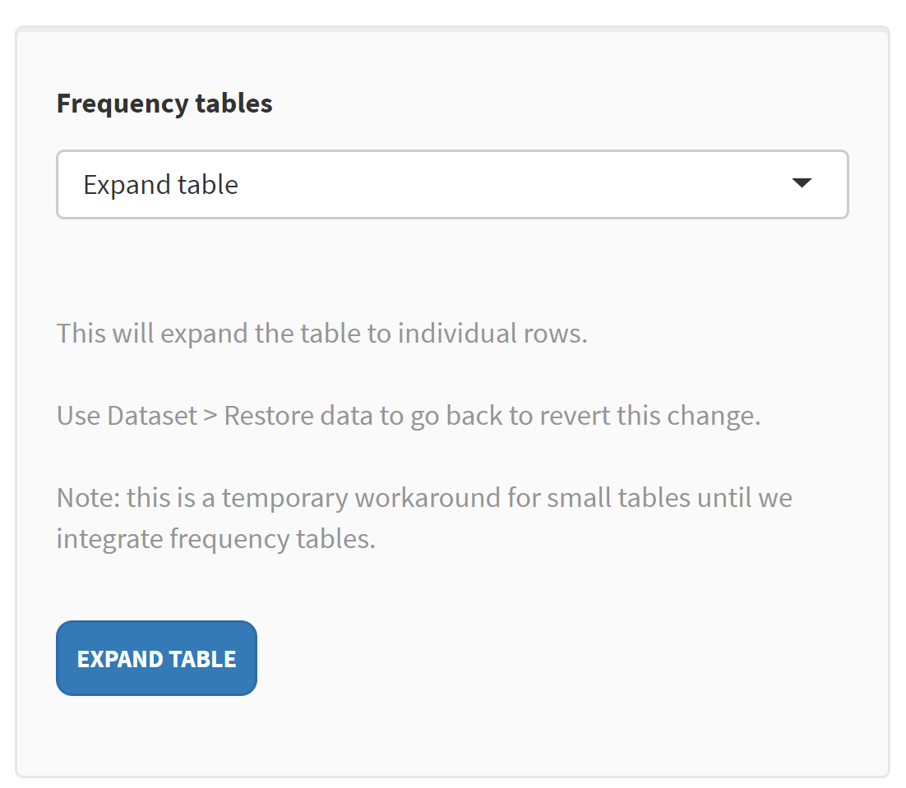
(Left-hand)
Control panel
changes to

